Slide 1
Hue Access to the CenturyLink Data Lake
An Introduction to your New Access

Slide 2
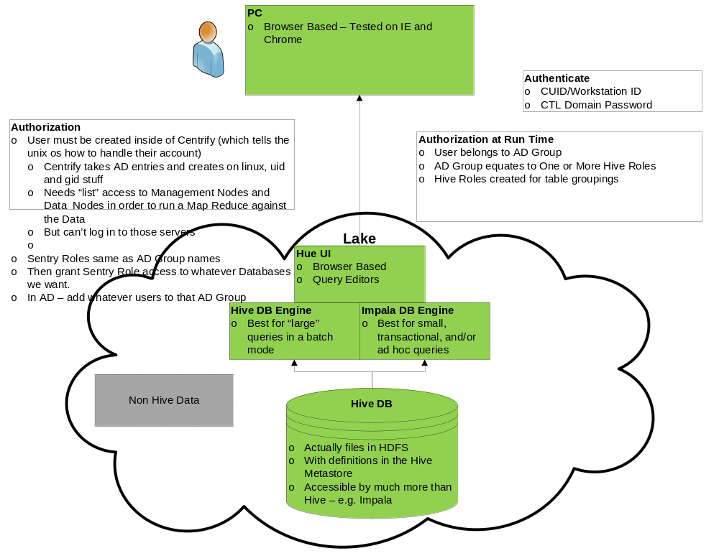
Hue Access Diagram
Last Update: 1/12/2017

Slide 3
Hive Instructions sent to John/Joe/David
Hue is a web based GUI that allows access to parts of the Data Lake environment.
  Try logging in to hue (link is to our development environment, we will provide production later.). Login should be your cuid and normal domain password.
  This has worked in IE and not Chrome – let us know if you are using a different browser so we can note how that works.
  Also note that the login screen is having intermittent issues. You may have to try it a few times. (We are tracking the issue on a problem log).
Once in hue, you will see many different options. However, you should only have permissions to execute:
  Main Menu – Query Editors – Hive and Impala.
  When you invoke either of these, you will be presented with a query interface – where you can type sql commands, and then more – here are links to Hive and Impala documentation.
  We will refer to a “hive database”, but it can be queried by Hive or Impala – both use the “hive metastore”, and thus we’ll just call it a hive database.
  A hive database, would more likely be a single schema within a larger Oracle database – if you are used to Oracle granularity when we use the term “database”. Hive can’t have multiple schemas within one database – it is really one hive database per subject.
  And so here are the hive databases you should have access to:
    ants
    cdbi
    cdmt
    ems
    netstats
    nma
    ntm
    oneremedy
    opsdb
    proddb
    syslogs
    telcordia
Finally, I’ve copied Tony Arlt and Brandon Oubre from our Infrastructure and Dev teams respectively. Go ahead and reply-all with any issues that you have – so that the other users are aware and so that either Brandon or Tony can reply. (And remember we’re just starting here, so we appreciate you working with us to get through issues).
Last Update: 1/12/2017

